Slide 1
FARMLINK
-Innovation through Automation
TEAM MEMBERS
- FARWESH K N
- ARUN M
- LATHANGI E
- RAJAVEENI S
- DIVYASHREE S

Slide 2
Why Indoor Farming?
The Future of Indoor Cultivation
Automation Systems
OVERVIEW
Prototype
Monitoring Systems
Benefits of our Automation Systems

Slide 3

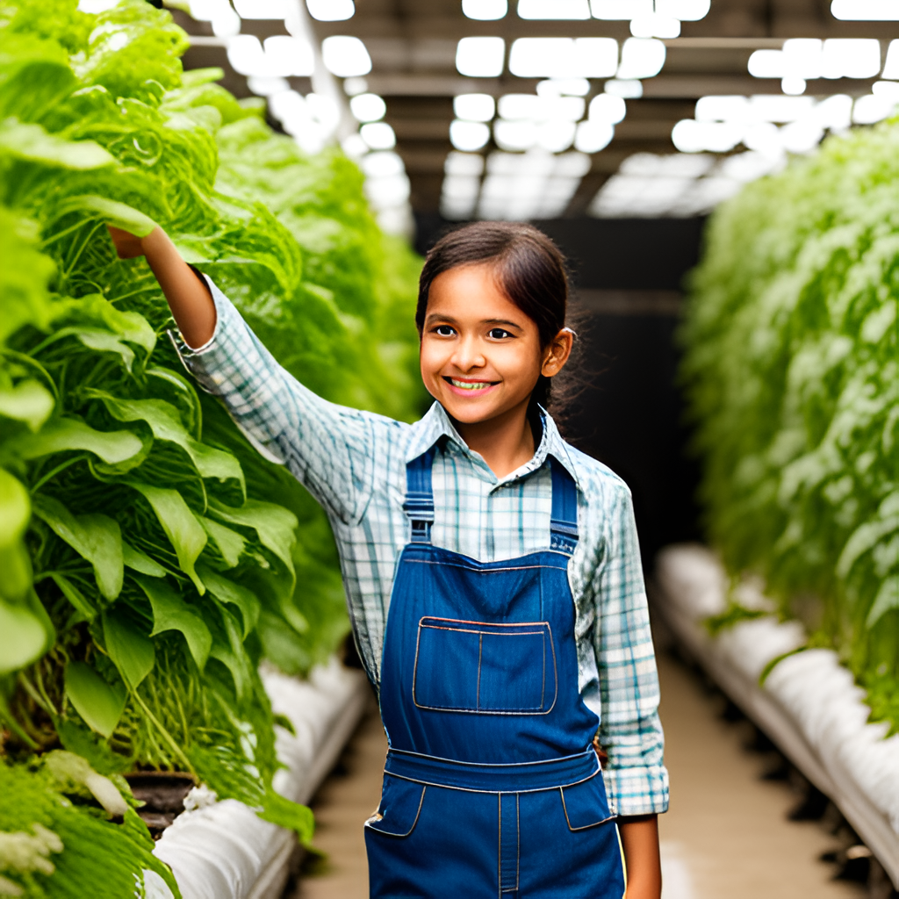
Inefficient techniques and inconsistent maintenance of ideal conditions in Indoor Farming have a negative impact on the quality and quantity of yield, resulting in increased labor costs and decreased productivity.

Slide 4
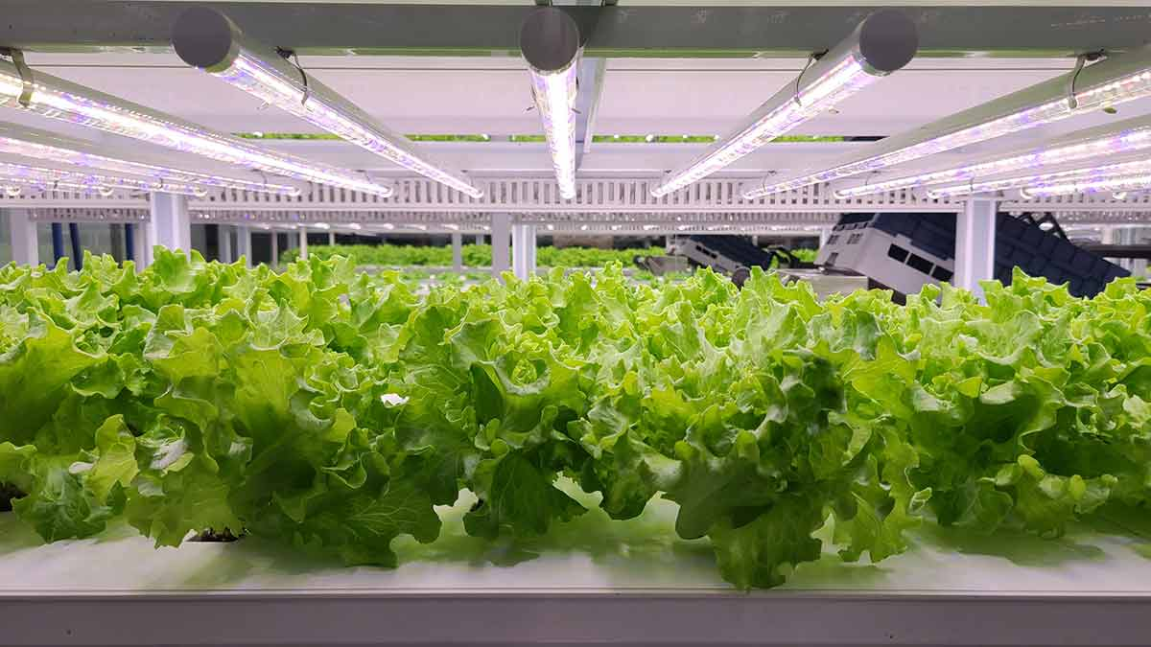
Why Indoor Farming?
It supports urban agriculture.
Minimizing diseases and adverse weather effects.
Indoor farming boosts crop yields by minimizing pests.
Efficient resource usage, ensuring optimal water, energy, and land utilization.
And reducing transportation costs.

Slide 5


SDG GOALS
Primary Goal ~
~ Secondary Goal

Slide 6
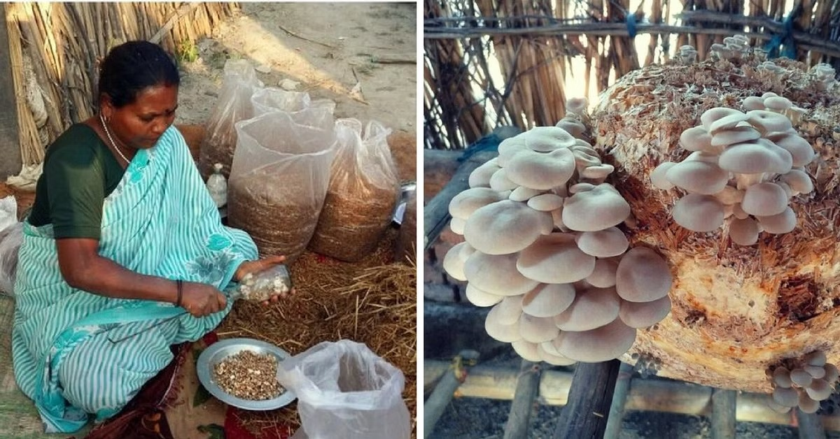
Existing Solution
Timer based system
Usage of manual labour
Traditional farming
#monitoring is a issue

Slide 7
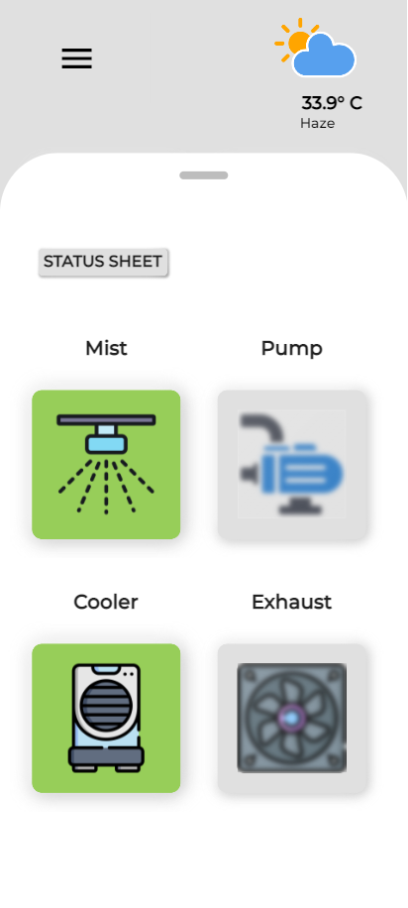
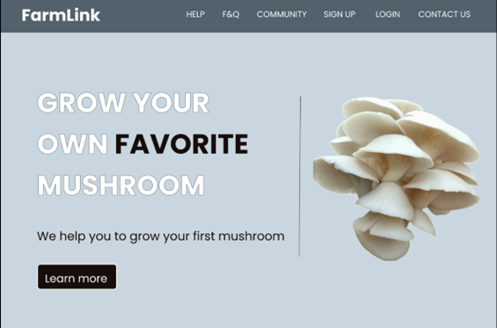
Proposed Engineering Solution
Automation System to maintain ideal condition.
Monitoring system using android application

Slide 8
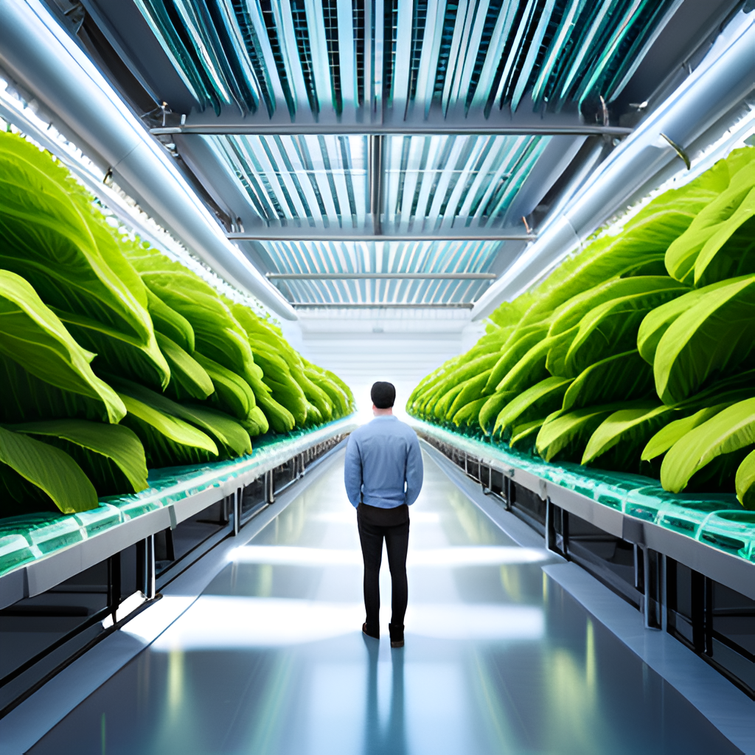
The Future of Indoor Cultivation
Automation
Monitoring systems
Precise adjustments
Task automation
Manual intervention
Time-saving
Scalable
Customizable
Small-scale

Slide 9
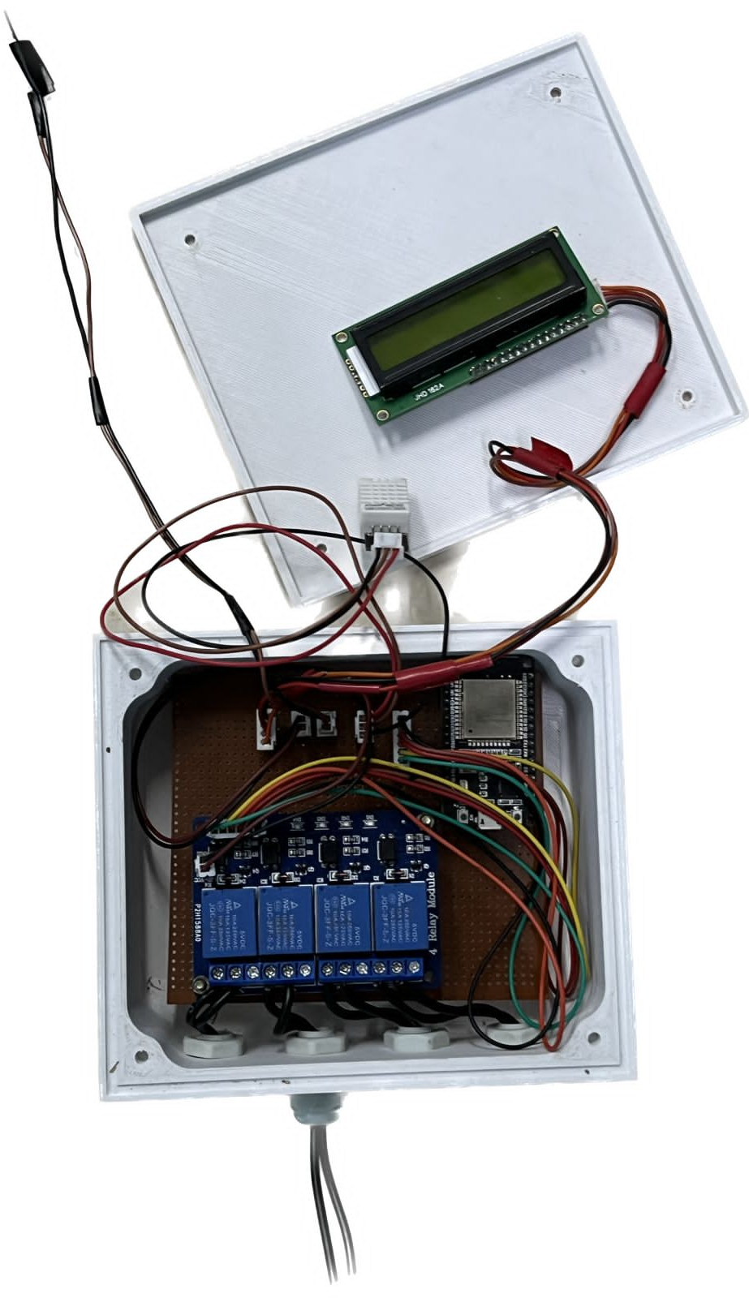
Automation Systems
Automation crucial for indoor cultivation
Monitor and control environmental factors
Sensors for temperature, humidity, and CO2
Controllers regulate lighting and irrigation
Actuators control valves and pumps
Reduces manual adjustments

Slide 10
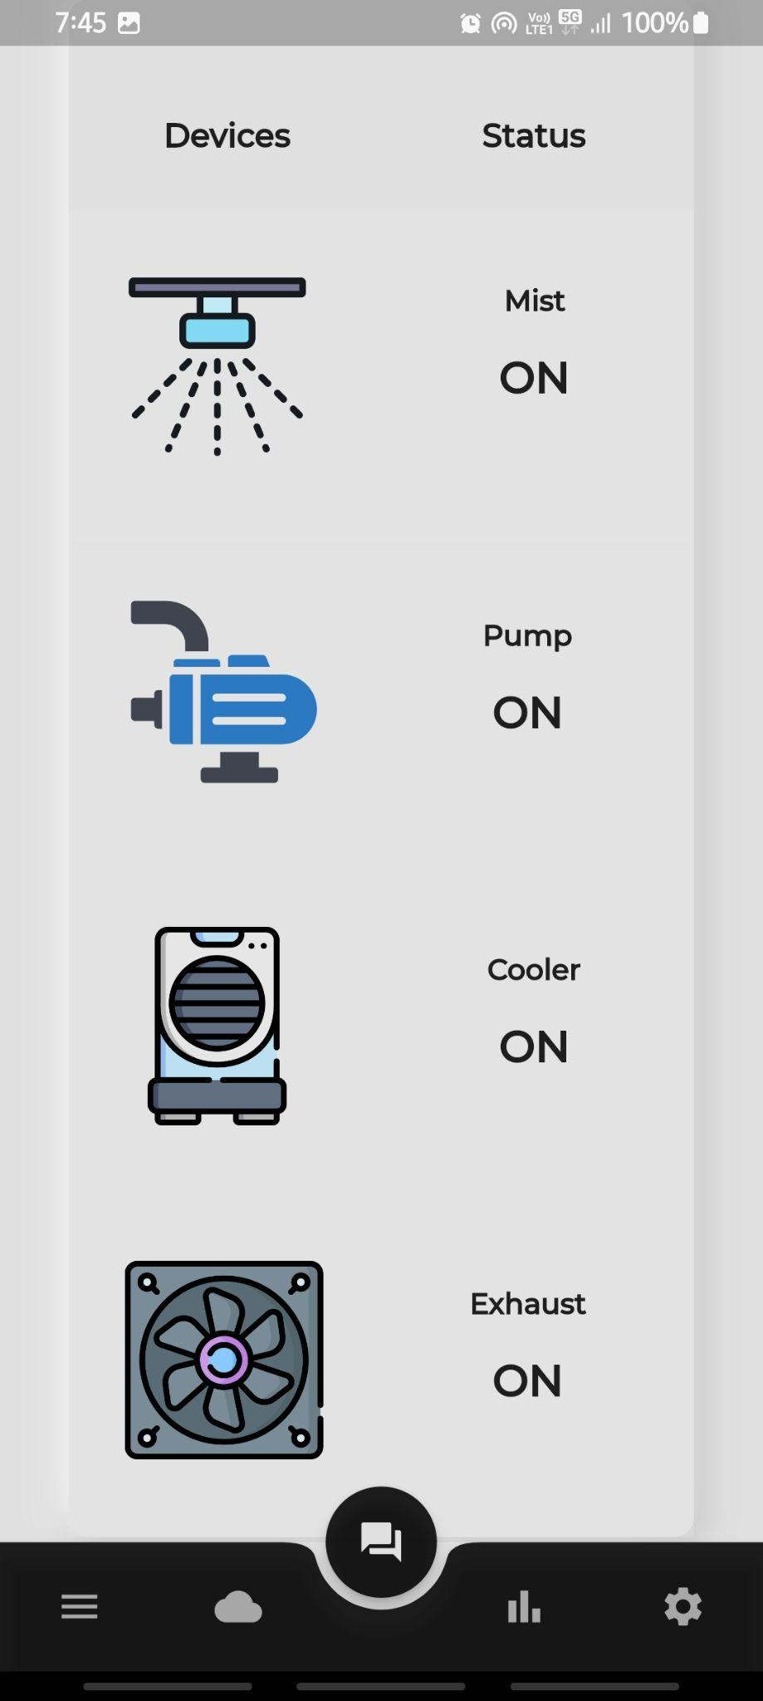
The indoor farming automation is controlled by a 4 channel relay module.
It is controlled by Esp32 Microcontroller.
With the help of a App we will be able to monitor the Automation System.
With certain Threshold range the automation will be controlled.

Slide 11
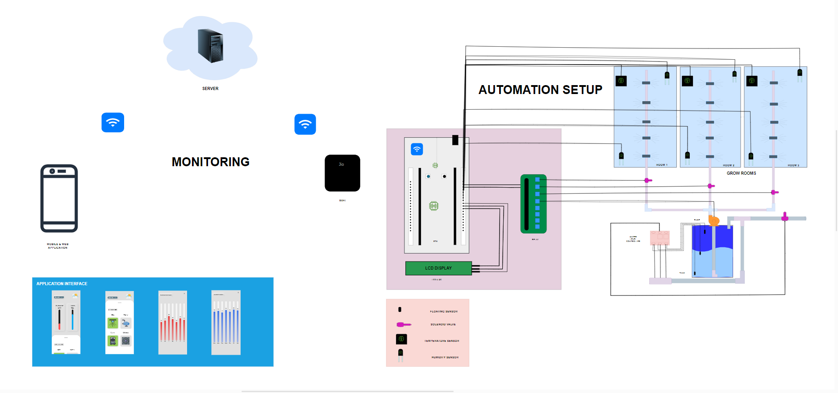
Architecture Diagram

Slide 12
SCOPE
Achieving highest conversion ratio using in-house formula
Increasing yield using improved formula.
t
Converting mushrooms into value added products.
Security and surveillance
Collecting complete growing data from dark room, incubation, fruiting and harvest.
Analyze mushroom nutrition and Enhance nutrition properties

Slide 13
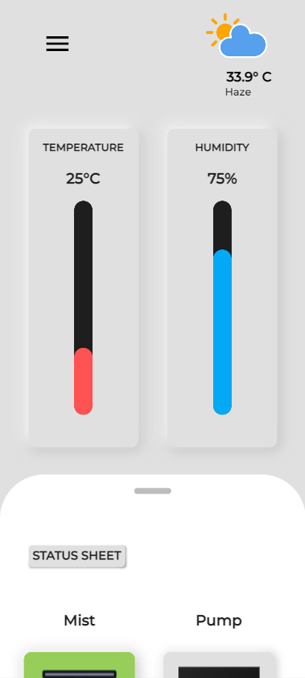
Monitoring Systems
Sensors monitor temperature, humidity, CO2, light, and soil pH.
Data informs decision-making.
Temperature sensors are used to maintain ideal temperature.
Humidity sensors are used to control moisture levels.
CO2 sensors regulate photosynthesis.
Other sensors measure light and soil pH.
Integration enables precise control.
Creates controlled environment for crops.

Slide 14
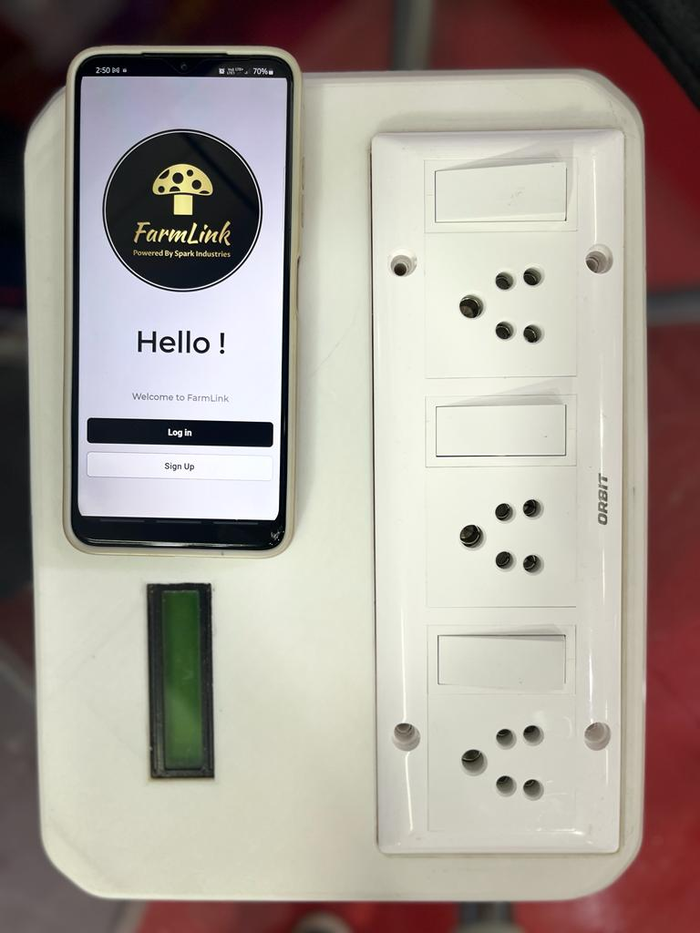
JUSTIFICATION
Successful prototype developed.
Commercial viability achieved with successful .
prototype.Easy Monitoring
Low Manual work
Increased Conversion rate .

Slide 15
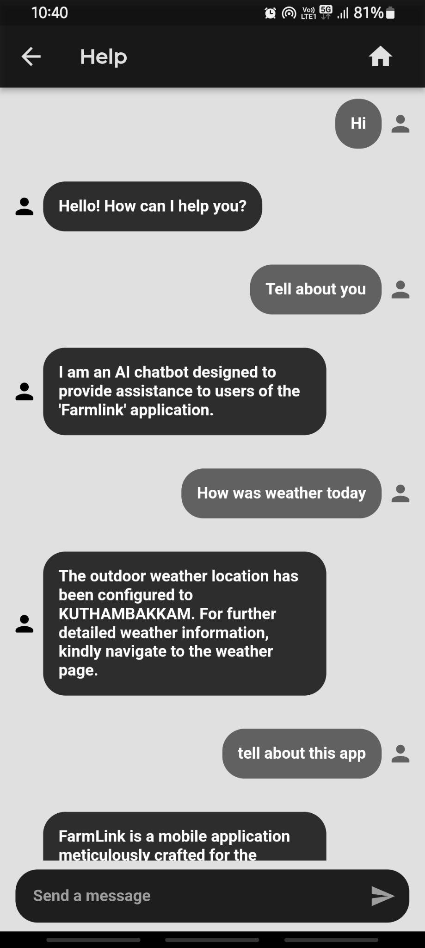
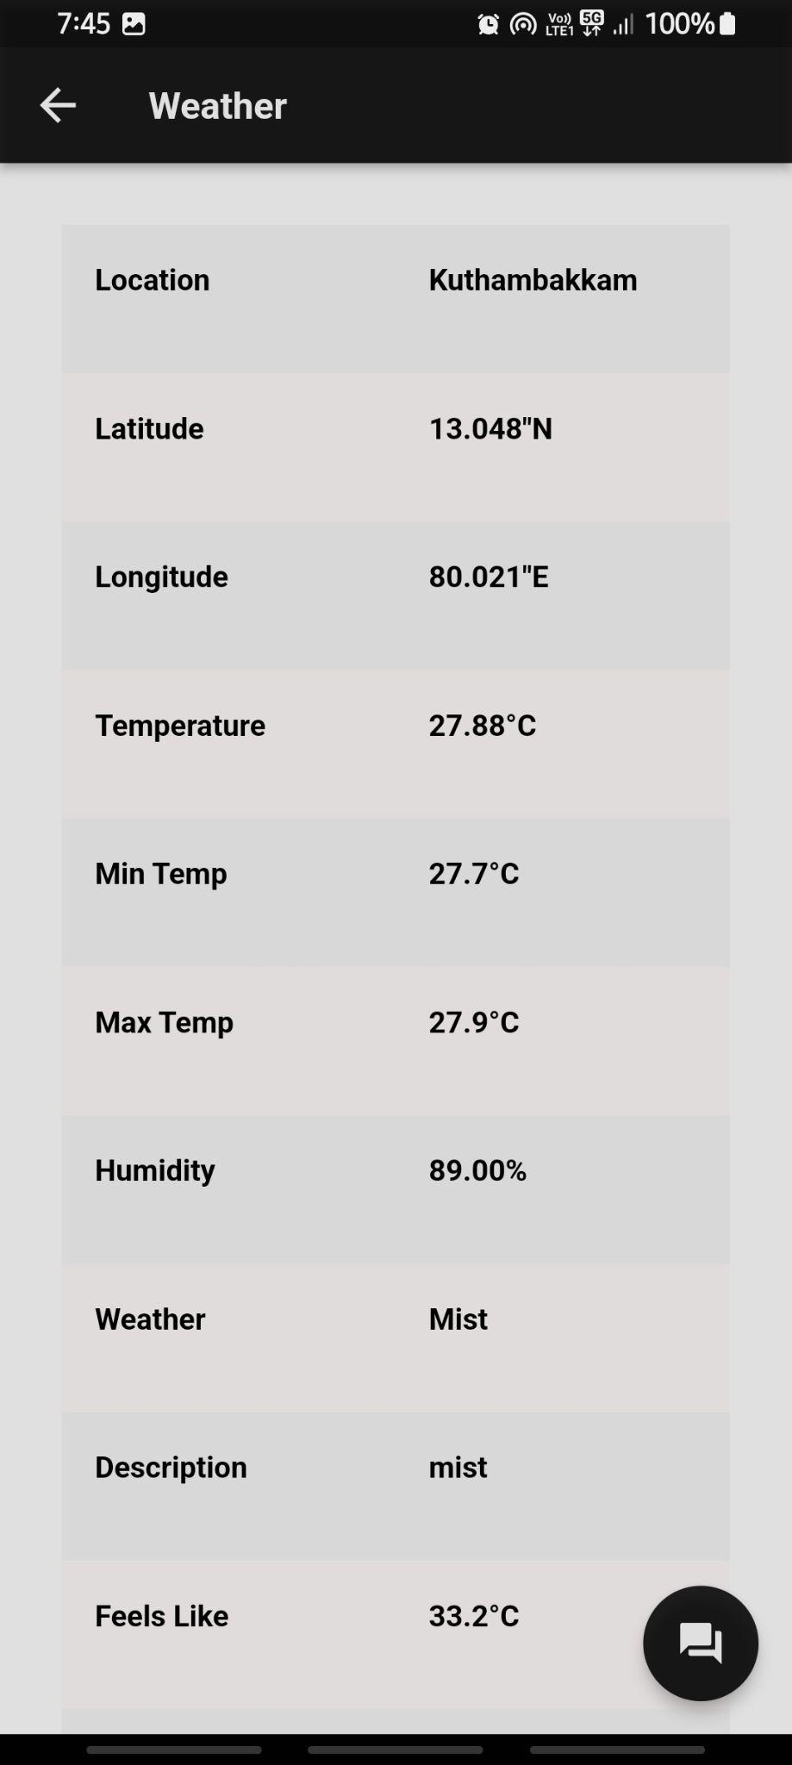
App Features
Data Analytics and Insights:
Visualization : Graphs & Charts
Correlation : Data & Growth
Predictive Analytics : Forecast & optimize
Remote Monitoring and Control:
Cloud Integration : Firebase
User Profiles : Access Control
Expert Guidance and Support:
Guided Set-Up : Simplified Setup
Help Center : FAQs & Guides

Slide 16
Parameters
S.No | Parameter | Range
1 | Moisture | 65-85%
2 | Temperature | 22-28*C
3 | Mist sprayer | 2 L/4hr
4 | Humidifier | 900 ml/hr
5 | Light intensity | 200-700 LUX
6 | Air flow method | Positive Pressure
7 | Fan flow rate | 204 CFM
8 | CO2 level | 500-700 PPM

Slide 17
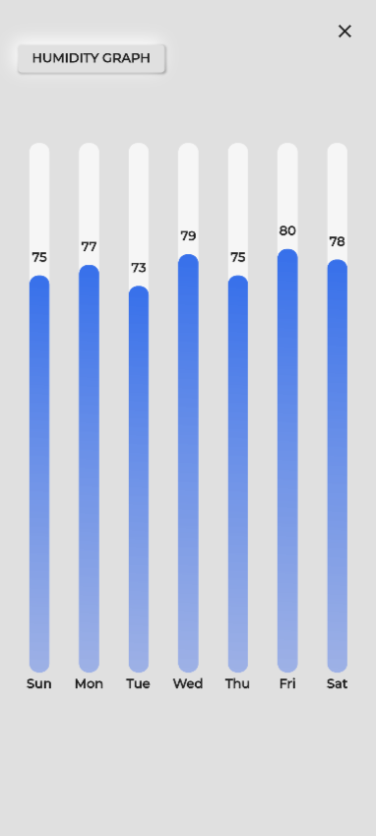
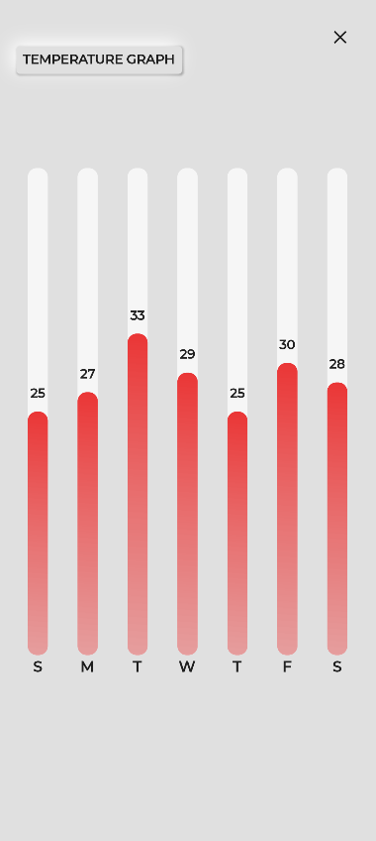
How to measure Success Metrics?
Data Collection of humidity and temperature for every minute
Increase in Final Yield
Increase in profit margin
Reduction of water and electricity usage

Slide 18
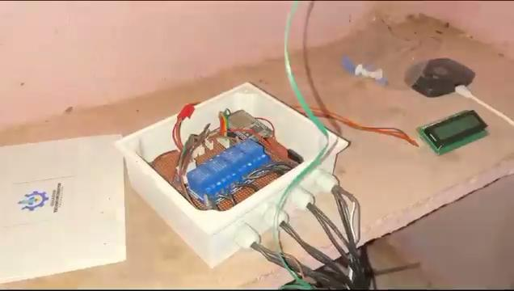

Slide 19
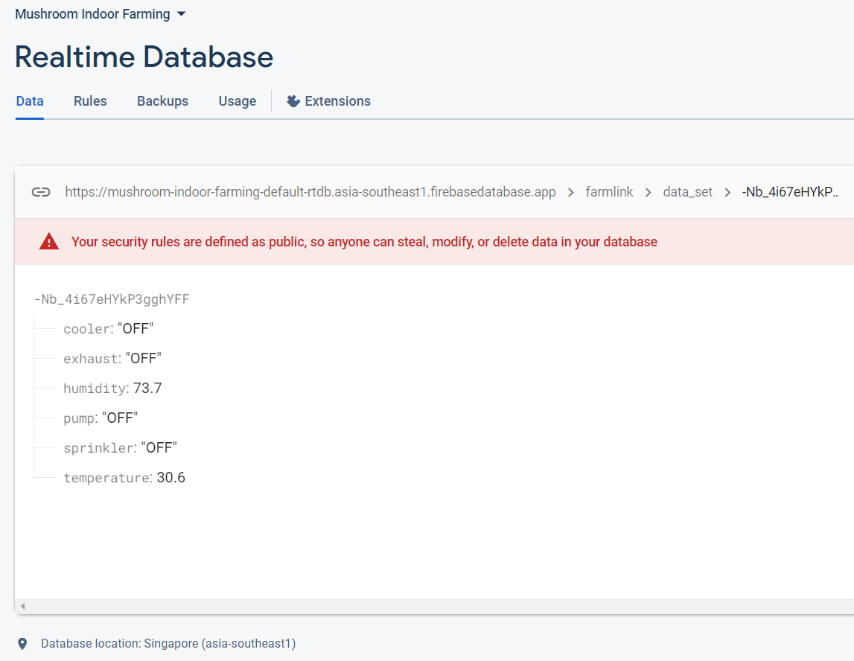
CLOUD ACCESS
A real-time database is being used to capture data updates.
We have enabled a real-time database to track all updates, both live and periodic.
This will allow us to collect and analyze data in real time, which will help us to improve our products and services using machine learning.

Slide 20
BUSINESS MODEL
B2C
The hardware such as small-scale hydroponic systems and smart grow boxes to home gardeners.
These services typically provide subscribers with access to a small-scale hydroponic system, a suite of smart sensors, and a mobile app that allows them to monitor and manage their system remotely.
B2B
Which helps farmers to monitor and manage their automated systems.
By directly selling the hardware product to farmers.
This software can be used to track crop growth, adjust environmental conditions, and optimize yields.

Slide 21

Benefits of Automation and Monitoring Systems
Automation of tasks like watering, fertilizing, and lighting increases efficiency.
Reduces labor costs.
Monitoring systems track environmental conditions.
Reduce the risk of human error and ensure consistent crop quality.
Helps growers make informed decisions.

Slide 22
THANK YOU

